Slide 1
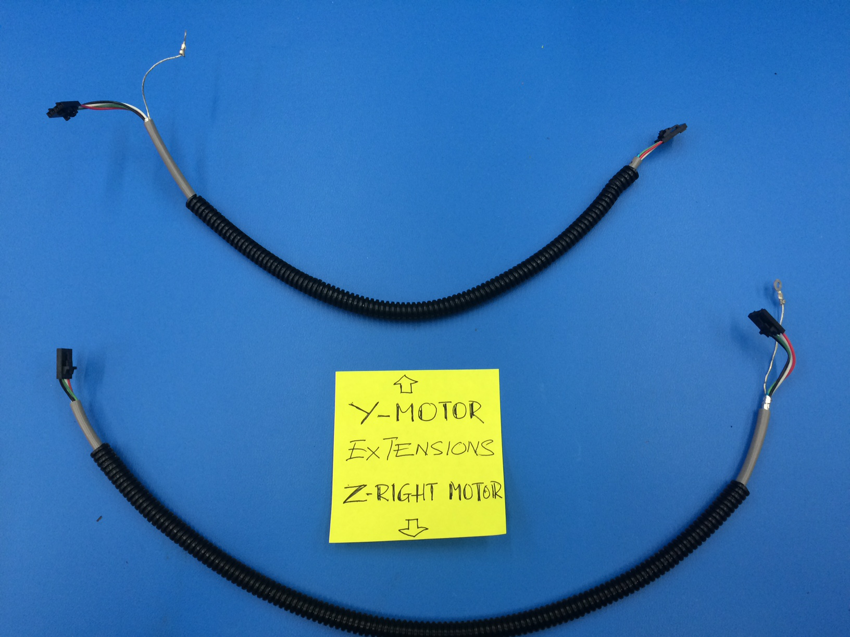
Mini - Daffodil
Y Motor & Z-Right Motor Extensions
[EL-MS0062]
[EL-MS0141]
- Trim shield 20 mm
- Strip wire 4 mm
[EL-MS0062]
- Trim shield 55 mm
- Strip wire 4 mm
Y-Motor:
- Grey cable L = 410 mm
- Panduit L = 305 mm
[EL-MS0141]
[EL-MS0062]
[EL-MS0062]
[EL-WR0099]
Grey Cable
- Trim shield 55 mm
- Strip wire 4 mm
[EL-MS0141]
Panduit
- Trim shield 20 mm
- Strip wire 4 mm
Z-Right Motor
- Grey cable L = 500 mm
- Panduit = 390 mm

